Slide 1
KRISHANU SAIKIA
SRMIST, KATTANKULATHUR
Theme - PUBLIC HEALTH

Slide 2
Hypothesis
Problem
Statement: Analyzing diverse public health datasets uncovers correlations between socio-economic factors, environment, and crime.
Importance: This holistic approach informs targeted policies and resource allocation, addressing public health challenges effectively.
Problem Statement: Simplifying access and analysis of public health data for better decision-making.
Theme: "Public Health Data Analysis" for enhanced data accessibility and usability.
Technologies Used
Languages: Python
Libraries: Pandas, Matplotlib, Streamlit
Data Sources: CSV files for COVID-19, sanitation, poverty, violence, environment, and convicts data.

Slide 3
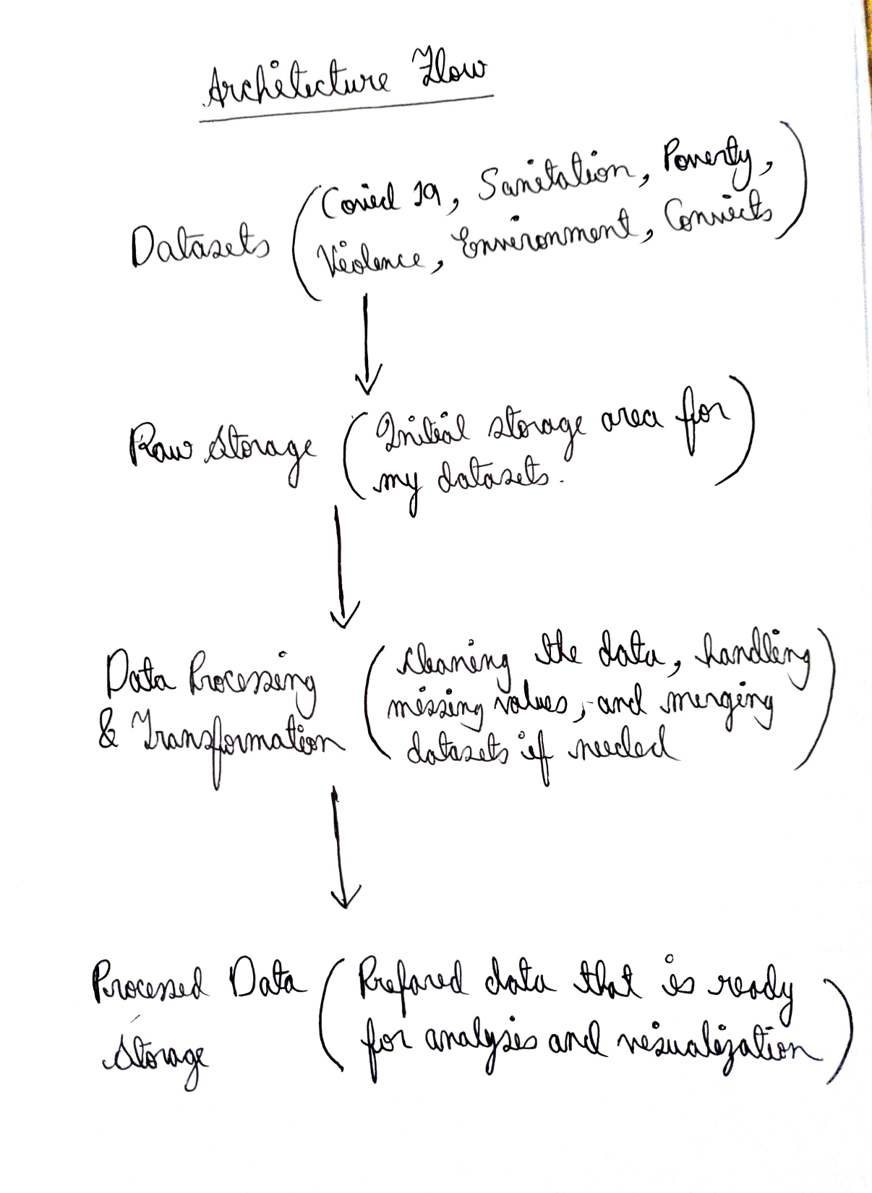
ARCHITECTURE FLOW

Slide 4
Insight and Recommendations #1
Insight
Utilizing public health data aids in identifying trends and patterns.
Disparities in sanitation access and poverty rates correlate with health outcomes.
Regional variations in crime rates impact public health outcomes.
Title of Insight
Sanitation Access and Health Outcomes: Correlation Analysis
Crime Rates and Public Health: Geographic Distribution
Poverty and Health: Exploring Disparities
Recommendation
Global: Promote international collaboration on data sharing for comprehensive insights
National: Develop targeted interventions addressing sanitation and poverty disparities.
State: Implement localized crime prevention strategies for improved public health.

Slide 5
Insight and Recommendations #2
Insight
Air quality is linked to environmental factors affecting public health.
Patterns in COVID-19 testing data reveal areas with testing deficiencies.
Addressing mental health is crucial for overall well-being in the community.
Title of Insight
Air Quality and Public Health: A Comprehensive Analysis
COVID-19 Testing Gaps: Identifying Areas for Improvement
Mental Health Awareness: A Critical Public Health Concern
Recommendation
Global: Advocate for international standards on air quality management.
National: Enhance testing infrastructure in identified deficient areas.
State: Develop and promote mental health awareness campaigns and support services.

Slide 6
Insight and Recommendations #3
Insight
Sanitation practices significantly impact public health outcomes.
Poverty is a critical factor influencing health disparities.
Addressing domestic violence is essential for community well-being.
Title of Insight
Sanitation Impact: A Deep Dive into Public Health Consequences
Poverty and Health Disparities: Unveiling the Connection
Domestic Violence: A Silent Threat to Community Well-Being
Recommendation
Global: Promote international collaborations for improved sanitation infrastructure.
National: Develop targeted health programs for poverty-stricken communities.
State: Strengthen support systems and interventions for victims of domestic violence.

Slide 7
Walkthrough Video
Embedded a comprehensive video walkthrough of the Public Health Insights App.
Demonstrated the functionality, features, and key aspects of the code implementation.
The video is a guide for users, showcasing how to navigate the app and understand the underlying code.
VIDEO LINK :
https://drive.google.com/file/d/1p8ePVcZwylzrGOZ8lPgF-HPaKG8kHLpa/view?usp=sharing

Slide 8
THANK YOU

